Slide 1
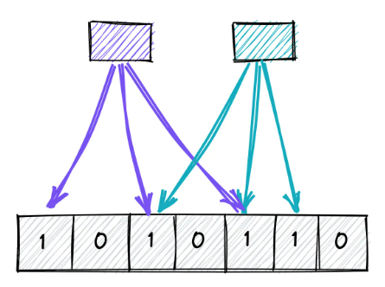
BLOOM Filter

Slide 2
Bloom Filters
What is a Bloom Filter ?
What are probabilistic Data Structures ?
Can it be used for String Similarity ? Does string similarity necessarily mean Phonetically equal strings ?
How does Bloom Filter Work ?

Slide 3
Bloom Filters
Bloom Filter is a probabilistic data structure used to test if an element is a member of a set.
Probabilistic Data Structures are data structures that provide approximate answers to queries about a large dataset, rather than exact answers. These data structures are designed to handle large amounts of data in real-time, by making trade-offs between accuracy and time and space efficiency.
The key advantage of probabilistic data structures is their ability to handle large amounts of data in real-time, by providing approximate answers to queries with limited space and computation.

Slide 4
Bloom filters work Based On
BIT ARRAYS : Bit Arrays are initially set to 0 . For each incoming item , the item is hashed through K hash functions and the bits are set. To check if a new item belongs to the set the new items are hashed through same K functions and if all the bits are set then the item exists in the set.
HASH FUNCTIONS : Murmer, SHA-1, FNV Hash, CITY HASH and SIPHash can be used to Hash the strings.

Slide 5
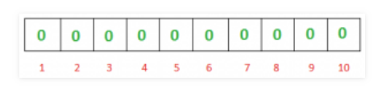
BITARRAY
If you want to keep track of the numbers from a given range, then you want to use Bit Array. As soon as you got a number, just make the bit of that index equals to 1(or set). And, if in future you want to check whether you have seen that number just go to that index which is equal to your number and see the value if it is 1 then you have previously seen it otherwise not.

Slide 6
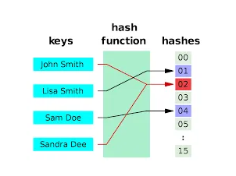
Hashing
Hash functions take a string as an input and give a number.
SHA-1, murmer3, FNV series hash, Jenkins Hash.
murmer3 hash function is very fast and uniformly distributed across its values.

Slide 7
References
Bloom Filters Explained - System Design
Bloom Filter: A Probabilistic Search Approach in Data Structures | by Aakash Bindal | Techspace | Medium
Bloom Filters (samwho.dev)

Slide 8
Chat GPT Response
Bloom filters and NYSIIS are two different algorithms used for different purposes, so it's not entirely accurate to compare them directly in terms of "better" or "worse." Let me provide some information on both to help you understand their differences: Bloom Filter:
Bloom filter is a probabilistic data structure used to test whether an element is a member of a set or not.
It is typically used for membership testing, such as checking if a given string exists in a large set of strings.
Bloom filters are very space-efficient and can quickly tell you if an element is definitely not in the set (false negatives are not possible, but false positives can occur).
They are not designed for string similarity comparison but rather for set membership testing.
NYSIIS (New York State Identification and Intelligence System):
NYSIIS is a phonetic matching algorithm that converts words into a phonetic code based on their pronunciation.
It is commonly used for phonetic matching to find similar-sounding words or names.
NYSIIS can be useful for tasks like record linkage, spell-checking, or fuzzy string matching based on pronunciation.
It is not designed for set membership testing like Bloom filters.
In summary, if you are looking to check membership in a set efficiently, a Bloom filter would be a better choice. On the other hand, if you need to compare strings based on their pronunciation or phonetics, NYSIIS would be more suitable. The choice between the two algorithms depends on the specific use case and requirements of your application.

Slide 9
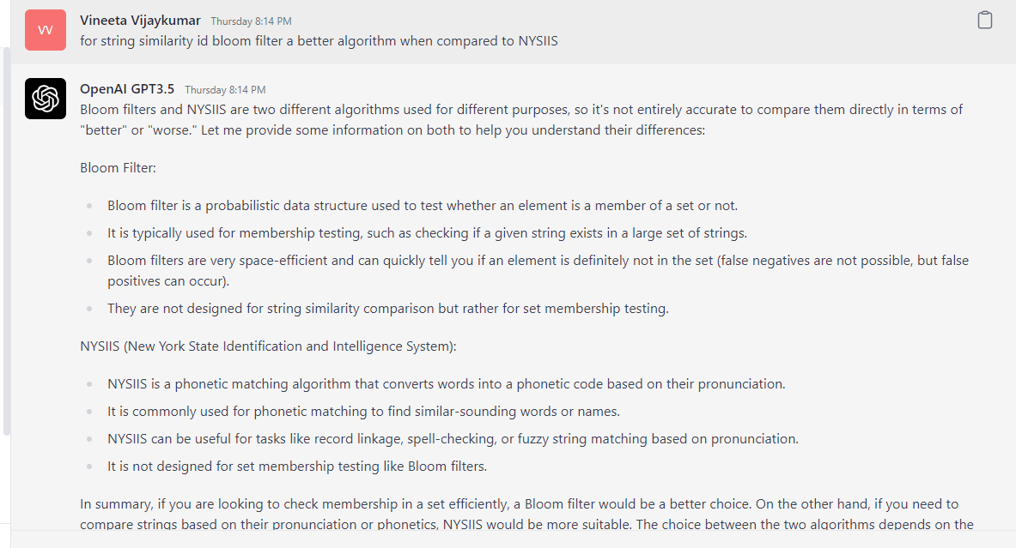

Slide 10
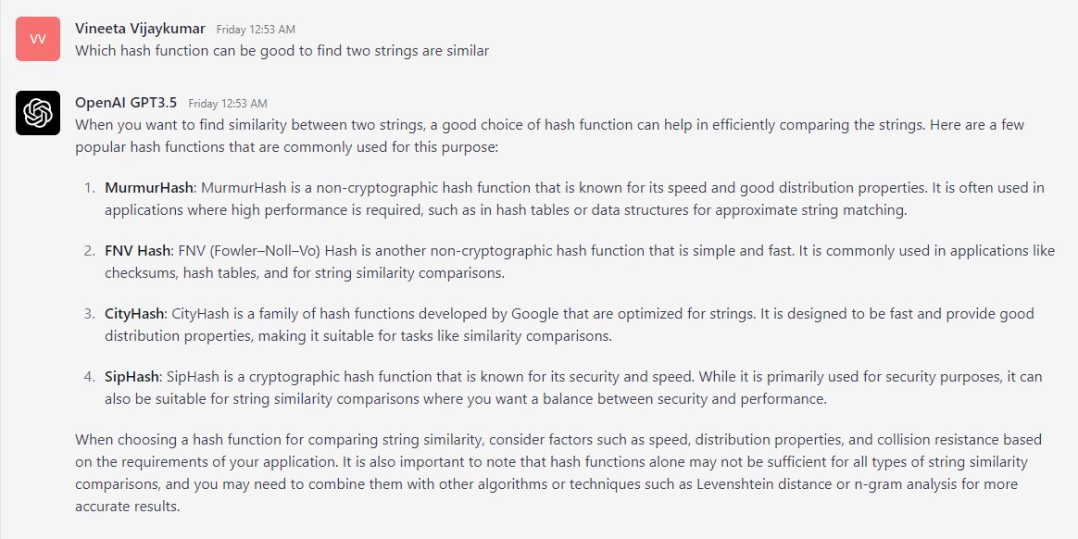
Which hash functions are good to find if two strings are similar.

Slide 11
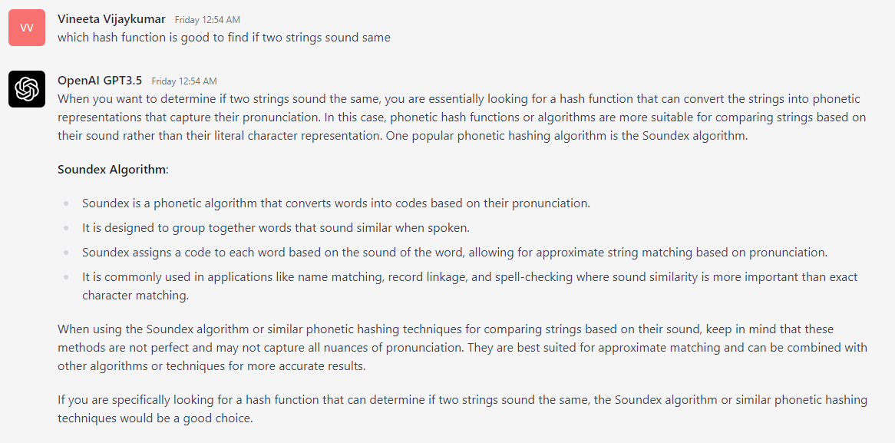
Which hash functions are good to find if two strings sound the same.

Slide 12
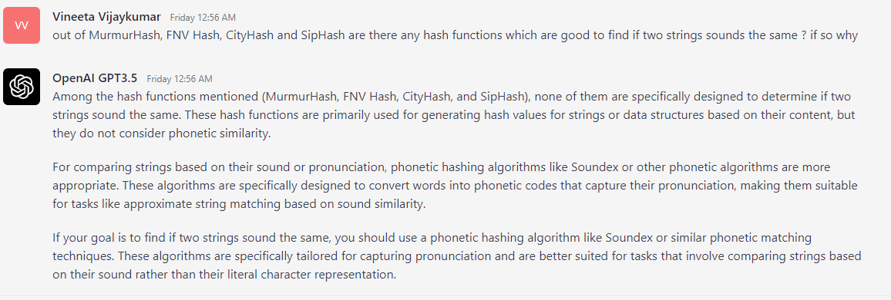
Out of MurmurHash, FNV Hash, City Hash and SipHash which functions are good to find if two strings sound the same.

Slide 13
Bloom Filter or NYSIIS
Bloom filters and NYSIIS are two different algorithms used for different purposes, so it's not entirely accurate to compare them directly in terms of "better" or "worse." Let me provide some information on both to help you understand their differences:
Bloom Filter:
Bloom filter is a probabilistic data structure used to test whether an element is a member of a set or not.
It is typically used for membership testing, such as checking if a given string exists in a large set of strings.
Bloom filters are very space-efficient and can quickly tell you if an element is definitely not in the set (false negatives are not possible, but false positives can occur).
They are not designed for string similarity comparison but rather for set membership testing.
NYSIIS (New York State Identification and Intelligence System):
NYSIIS is a phonetic matching algorithm that converts words into a phonetic code based on their pronunciation.
It is commonly used for phonetic matching to find similar-sounding words or names.
NYSIIS can be useful for tasks like record linkage, spell-checking, or fuzzy string matching based on pronunciation.
It is not designed for set membership testing like Bloom filters.
In summary, if you are looking to check membership in a set efficiently, a Bloom filter would be a better choice. On the other hand, if you need to compare strings based on their pronunciation or phonetics, NYSIIS would be more suitable. The choice between the two algorithms depends on the specific use case and requirements of your application.

Slide 14
Bloom filters are useful where speed is a concern.
Observation
Worked for ABIGAIL. Output depends on False Positive threshold.
It did not work for VINEETA,VINITA pair or JOHN or JHON pair.
It might also depend on the hash function. Using a certain hash function can be better for string similarity.
Tried with SHA suggested for string similarity,
Need to figure out how to tune the algorithm.
Tuning is based on the probability of false positives allowed and number of strings input.

